Slide 1

Taste potentiated odor association is improved by prior experience but is still modality specific
Data Presentation:

Slide 2
Does odor pre-exposure increase learning rates for taste potentiated odor association tasks?

Slide 3
Does session number matter or days of training?
Primae facie it seems that when training animals to associate 200mM sucrose with a particular odor the days of training are more effective than number of sessions which jives well with the theory of consolidation during sleep.
An important notes is that the 3-Day group needs two more animals to match the sample size for the 6-Day group
The basic protocol for the experiment has each animal participating in 60 trials in a pre-training preference test (pre-test) where two-odors are delivered with water in equal amounts for 60 seconds until the animal licks the spout and stops 5 seconds after the first lick is detected. After each trial there is a 30 second inter-trial interval.

Slide 4
Taste-odor association time course
3 Days training (6 Sessions) AM and PM
6 Days training (6 Sessions) AM only
Day 1
50 trials AM with Paired Odor (Ethyl Butyrate)
50 trials PM with Unpaired Odor (Methyl Valerate)
Day 2
50 trials AM with Paired Odor (Ethyl Butyrate)
50 trials PM with Unpaired Odor (Methyl Valerate)
Day 3
50 trials AM with Paired Odor (Ethyl Butyrate)
50 trials PM with Unpaired Odor (Methyl Valerate)
Day 1
50 trials with Paired Odor (Ethyl Butyrate)
Day 2
50 trials with Unpaired Odor (Methyl Valerate)
Day 3
50 trials with Paired Odor (Ethyl Butyrate)
Day 4
50 trials with Unpaired Odor (Methyl Valerate)
Day 5
50 trials with Paired Odor (Ethyl Butyrate)
Day 6
50 trials with Unpaired Odor (Methyl Valerate)

Slide 5
Comparing modalities of olfaction
Combined (Retronasal + Orthonasal)
Pre-exposed to 2 odors in homecage
Not pre-exposed to any odor
Orthonasal Only
Pre-exposed to 2 odors in homecage
Not pre-exposed to any odor
Retronasal Only
Pre-exposed to 2 odors in homecage
Not pre-exposed to any odor

Slide 6

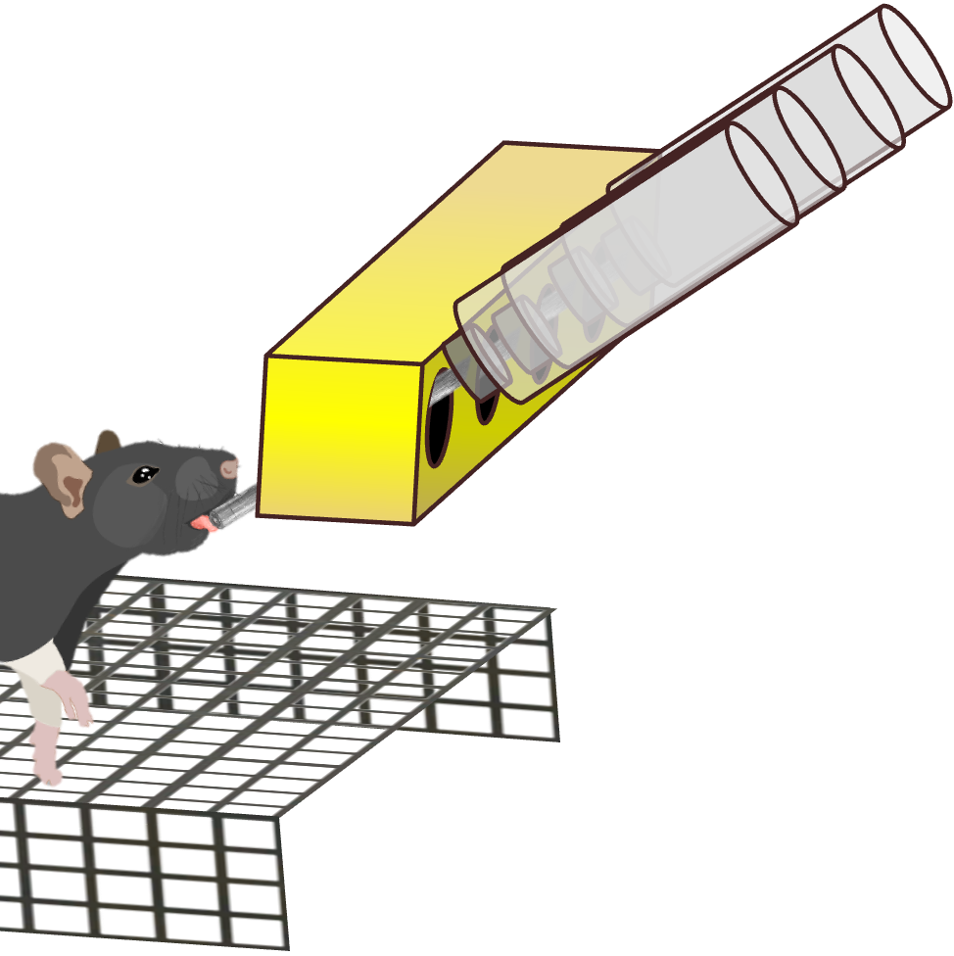


Comparing modalities of olfaction
Combined (Retronasal + Orthonasal)
Orthonasal Only
Retronasal Only
ODOR
ODOR
ODOR

Slide 7
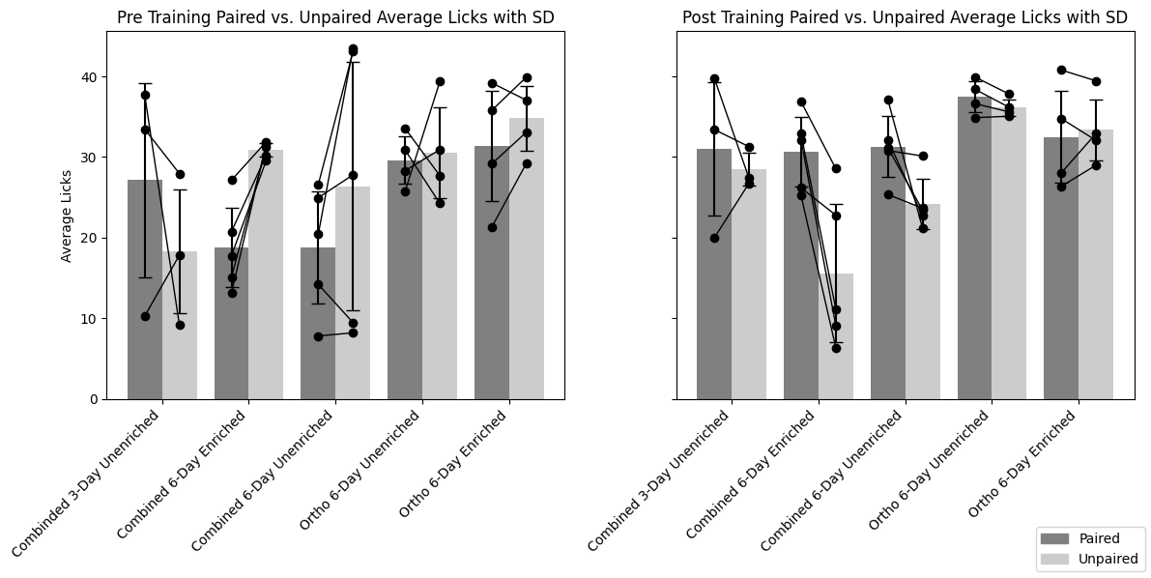
Comparison between pre-test and post-test sessions

Slide 8
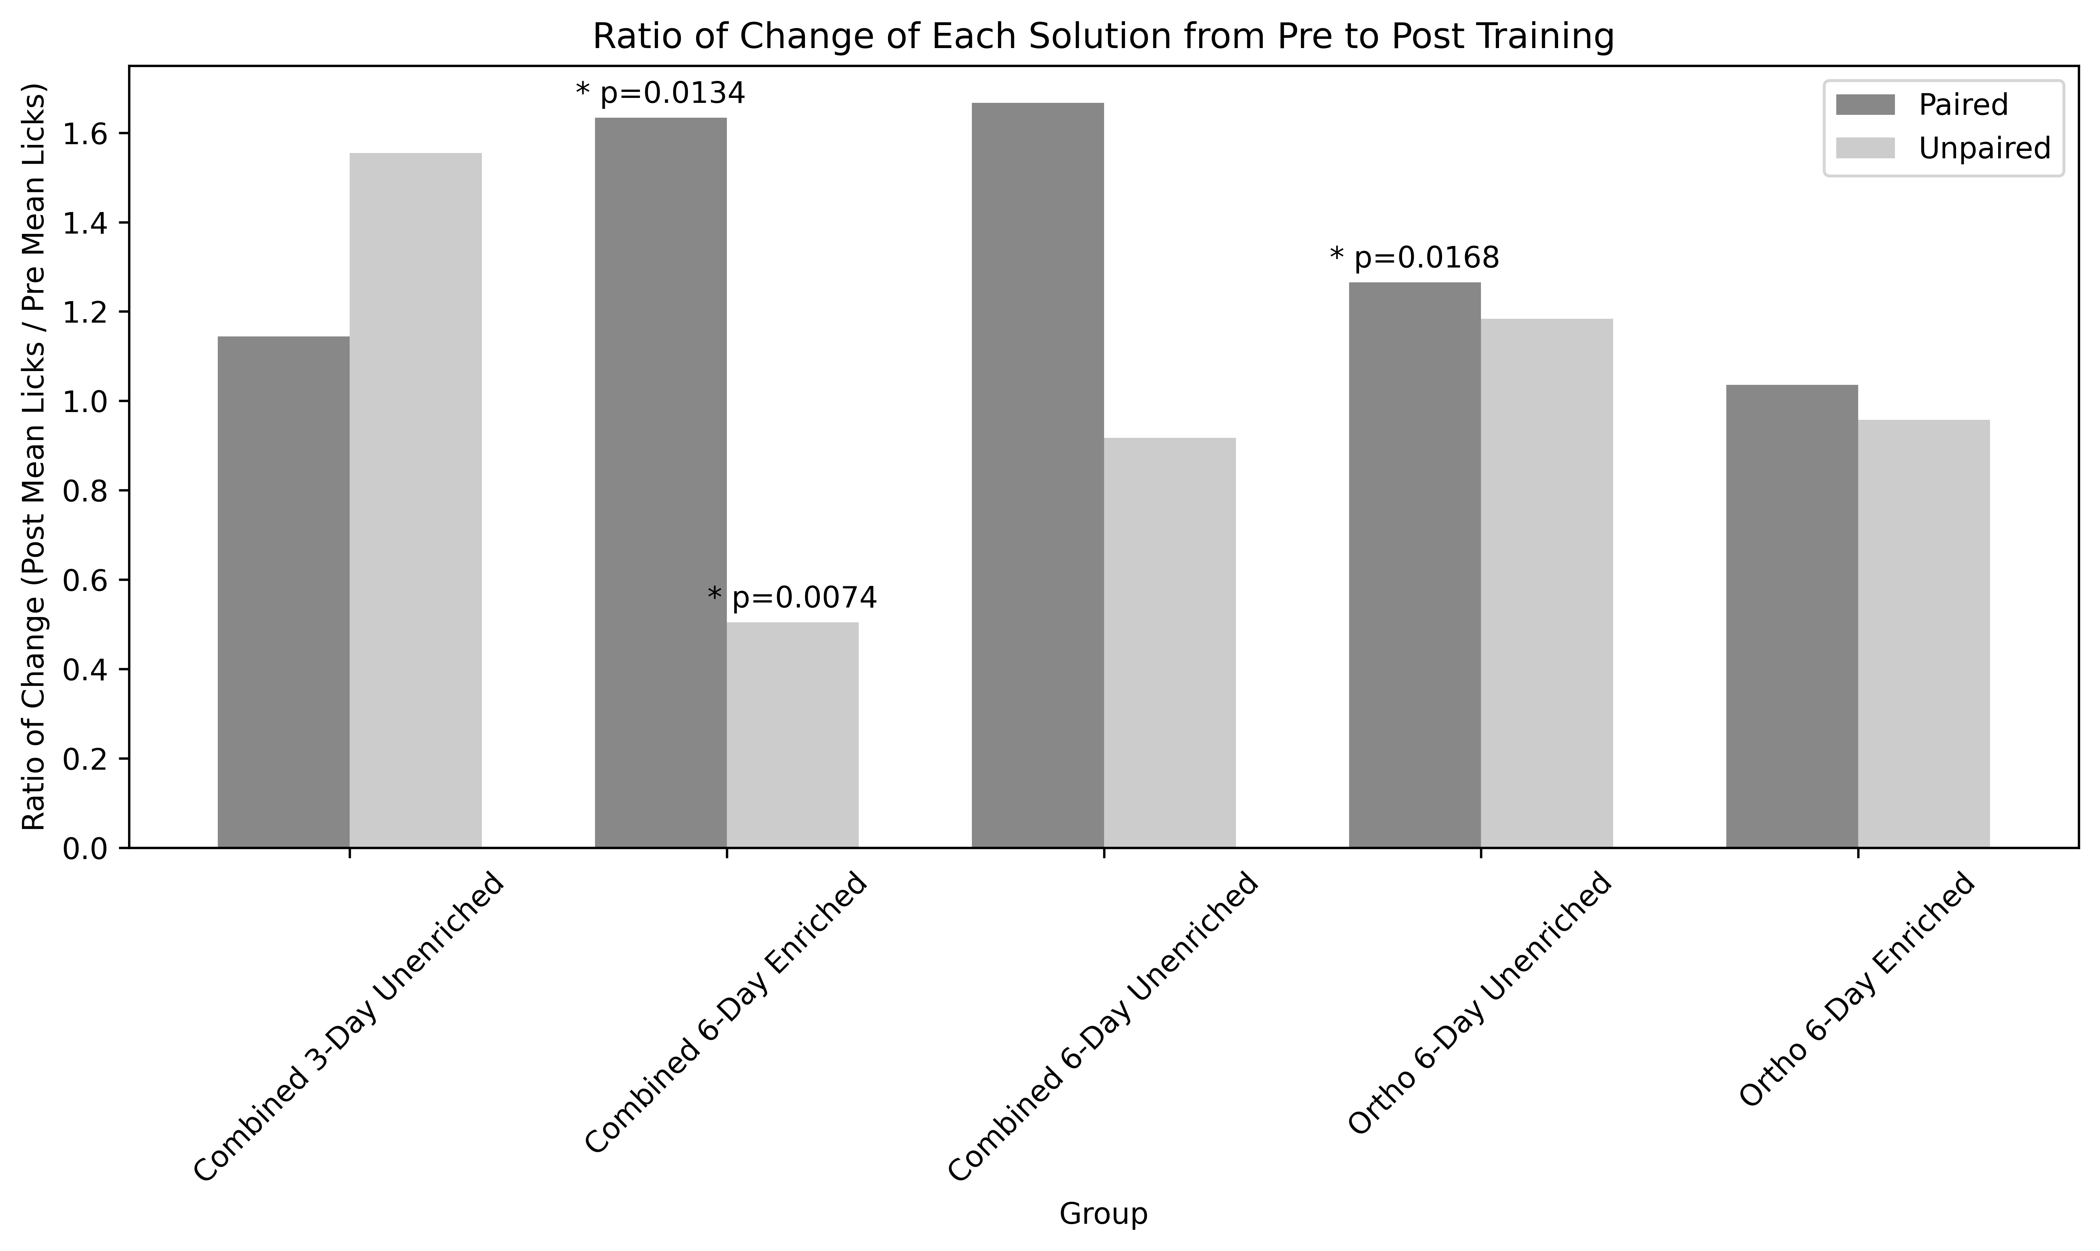
Comparison of changes in average licking to paired and unpaired odors

Slide 9
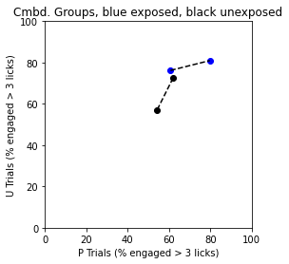
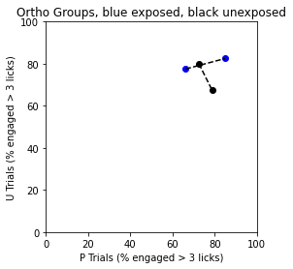
Trial engagement between ortho+Retro and Ortho alone

Slide 10
Next in experiments
The retronasal group without pre-exposure is already underway.
Removing ortho odors from the retronasal group still needs to be tested.
Because the concentration used for orthonasal was the same as retronasal it is possible that the animals did not perceive the odors during training or testing.
Meredith’s and another groups work use a 1000-fold higher concentration of odorants and Kay’s group demonstrated differences in odors with different “volatilities”.
The decision now is to determine what odors to use and how much higher the orthonasal concentration should be.
The other group also used a cone along with the porous material impregnated with the odor perhaps to constrain the odor headspace.

Slide 11
Next in Analysis
There are multiple measures we’ve yet to look at so far.
Latency to the first lick, number of bouts, length of bouts, number of licks for the first bout, and water normalized preference ratios are the next steps.
Another set of measures we would include is a discrimination index, palatability index, and change in preference index.
Despite missing some training data files, generally the participation and total exposure to each odor isn’t significantly different during training for either the paired or unpaired odor.
Based on some of Ben’s work there may be some analysis using logistic regressions to determine learning rates for each group.

Slide 12
Important changes
One future aim is to video record one animal of each group both to capture representative behaviors for each group and to properly power our data set.
Another is to add a second pre-test session and post-test session.

Slide 13
Meeting notes
Effect in all three analyses
Pre to Post Average Licking
Ratio of paired vs. unpaired pre versus post
Participate in more trials for the paired (count is 3 number of trials)

